Slide 1
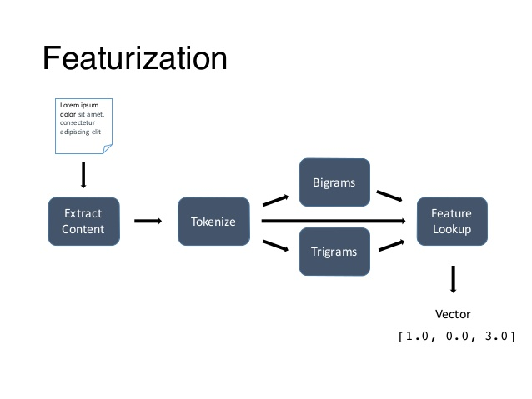
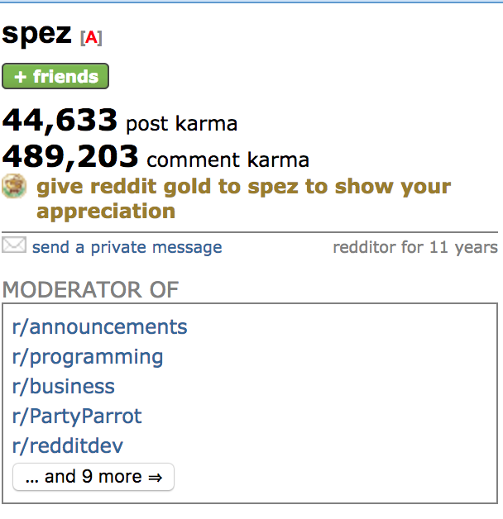
Featurization
Featurization is the process of taking an thing, for example text or a social media profile, and turning it into a vector.
This is important because a neural network takes a number vector as input and returns one as output.
Example: /u/spez
[44633, 489203, 14, 115, 112, 101, 122, 11]

Slide 2
Feature selection
Often, having too many features or the wrong subset of features can be just as detrimental as having not enough features.
It is computationally infeasible to search through every possible combination of features (O(2^{n})).
Instead, a greedy algorithm is generally used where a feature is either added or subtracted (different algorithms) each step if it is beneficial to the outcome. This algorithm is O(n²).

